Slide 1
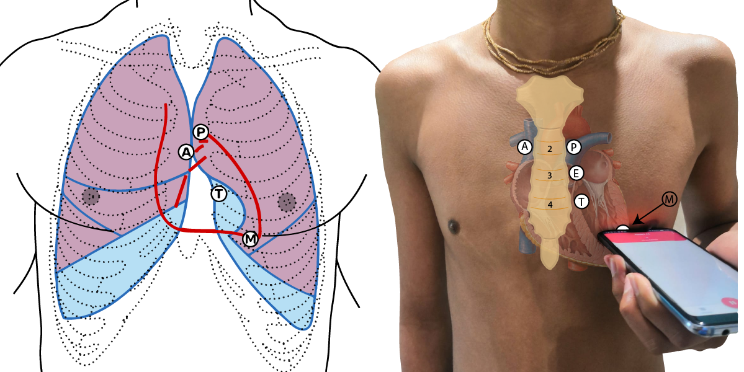
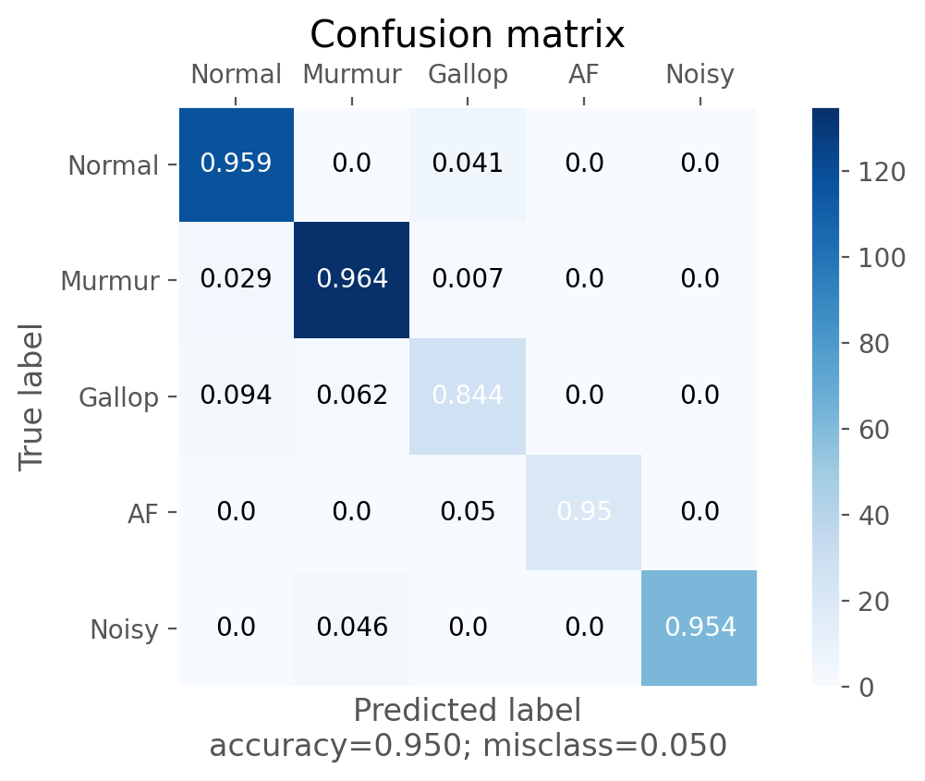
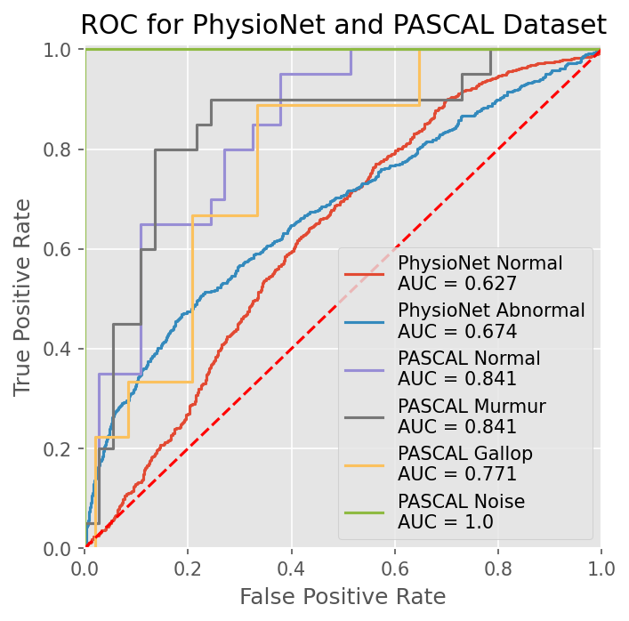
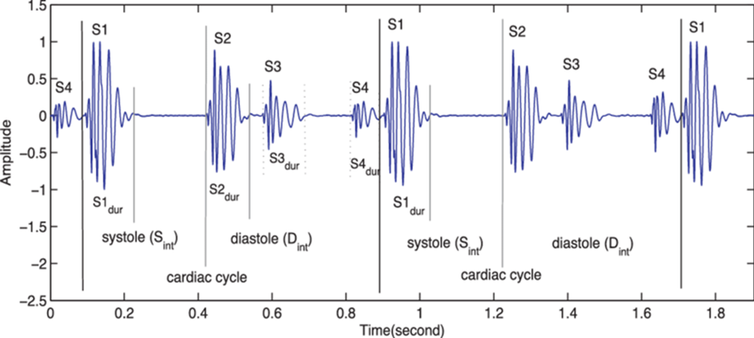
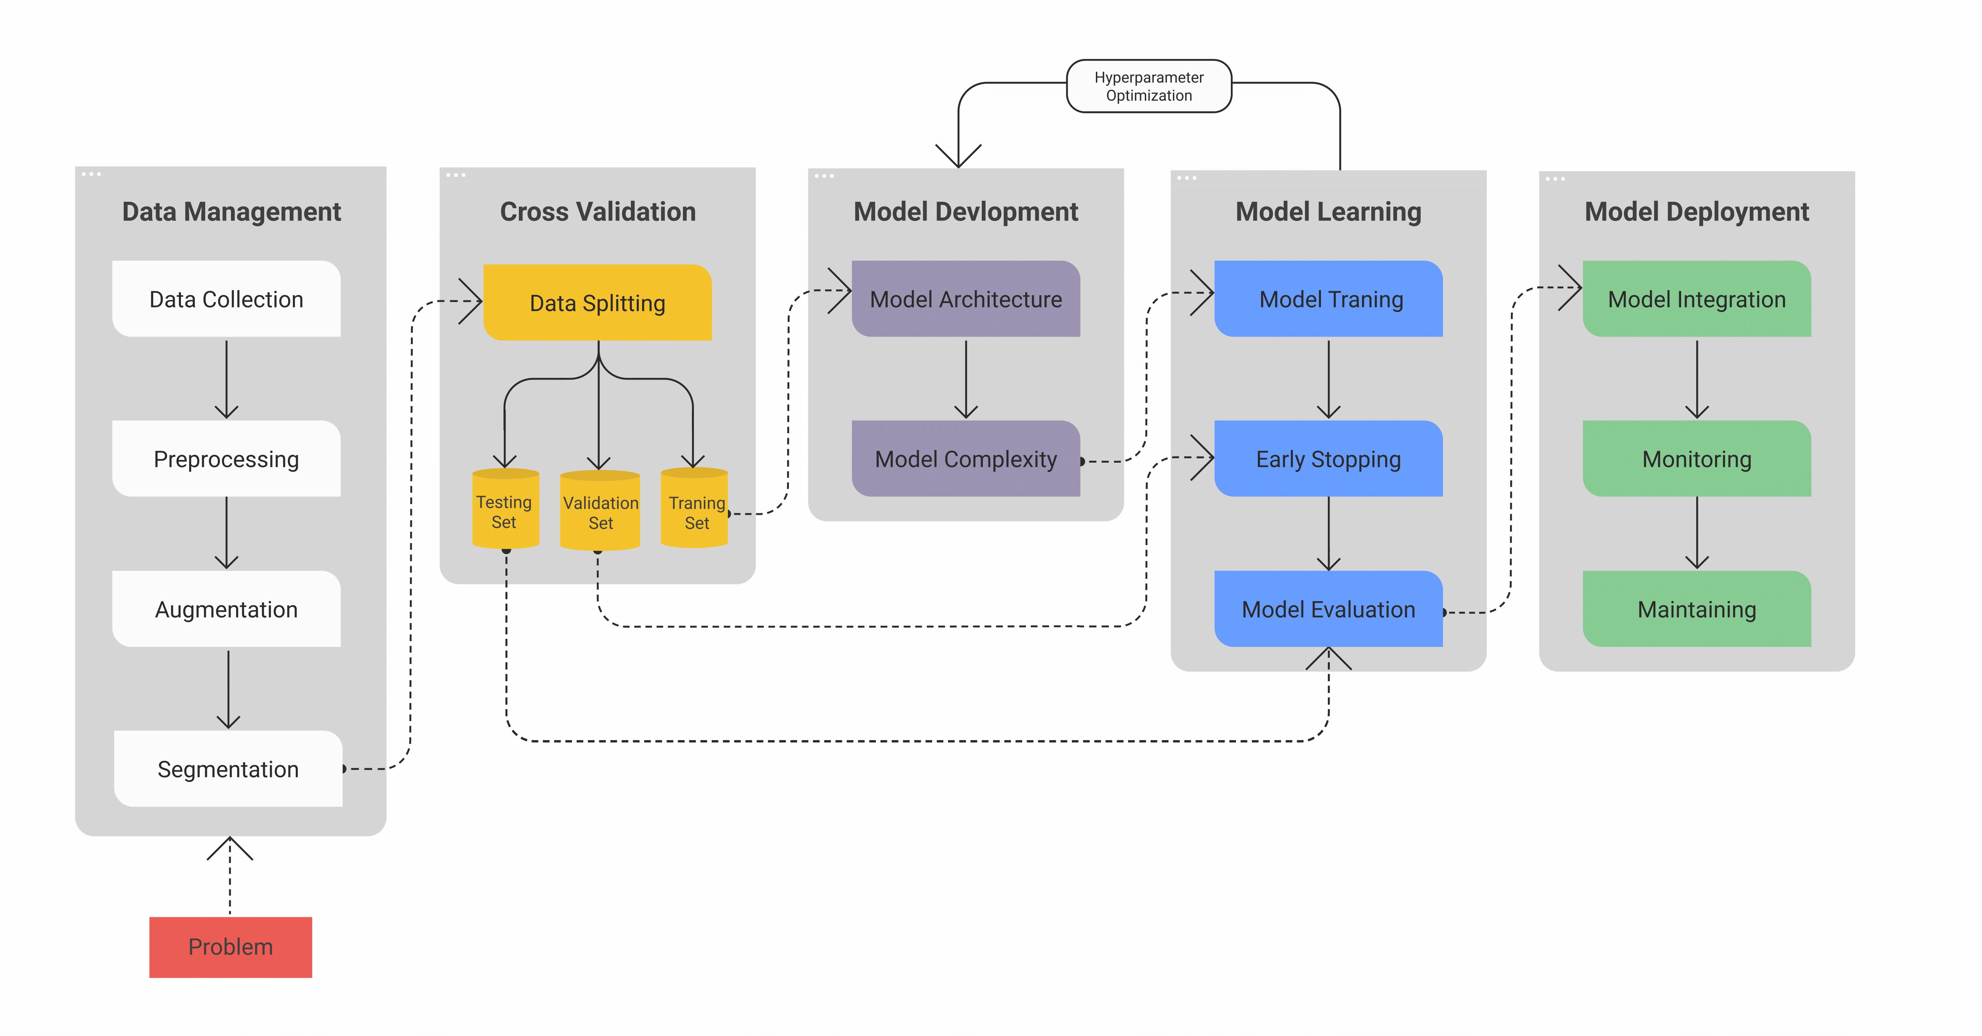
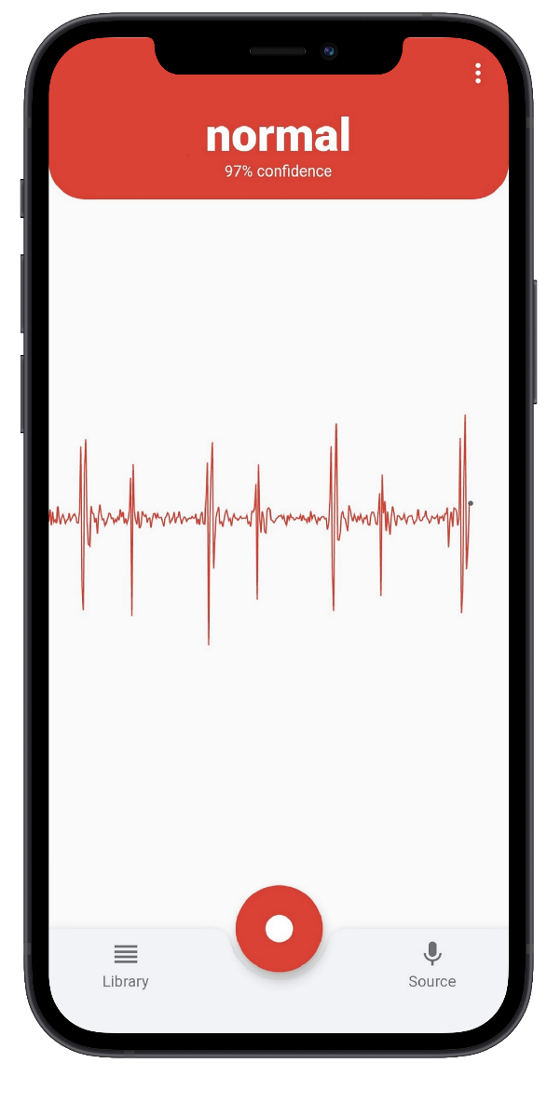
Employing Adversarial Machine Learning and Computer Audition for Smartphone-Based Real-Time Arrhythmia Classification in Heart Sounds
ENBM035
Aditya Kendre | Cumberland Valley HS Mechanicsburg, PA, USA
Problem An estimated three million cases of arrhythmia occur in the United States yearly (Mayo Clinic), and current detection methods have limited performance/aplication in pathologies and lack real-time classification capabilities.
Motivation
Create a fast and accurate model capable of detecting Cardiovascular modalities, specifically a variety arrhythmias in heart sound recordings (PCGs) without the need for specialized equipment.
Results
Methodology
Interpretation & Conclusions
The object of this study was to create a fast and accurate end-to-end heart sound arrhythmia detection system, capable of detecting abnormalities in real-time without specialized equipment. We proposed a Generative Adversarial Network (GAN), composed of a Convolution Transformer Generator and a Transformer Discriminator to detect abnormal heart sounds in a recording. The results from model testing and evaluation, along with results from the t-test revealed the proposed method reached better performance than the previous state-of-the-art methods. The introduction of heart sounds analysis with ECGs allowed for increased arrhythmia labels for classification and in a time-efficient manner. Furthermore, the proposed method showed real-world deployment capabilities for autonomous heart sound abnormality detection with recordings collected from a phone microphone.

